Slide 1















OPPORTUNE
Focused on Creating Opportunities

Slide 2

Problem Statement
Many students struggle to find internships due to the complex and time-consuming process of searching for opportunities that match their skills and interests.
Internship opportunities are spread across multiple platforms, making it challenging for students to access all relevant listings in one place.
Some companies charge students fees to secure internships, adding an unnecessary financial burden.
The current system often forces students to invest significant time and effort, reducing their focus on personal and professional development.

Slide 3
Opportune: A centralized platform for engineering students to find internships.
01.
Solution Overview
Focused on paid and free opportunities, eliminating the need for students to pay companies to provide an internship.
02.
Provides a user-friendly, responsive design to streamline internship searches.
03.

Slide 4

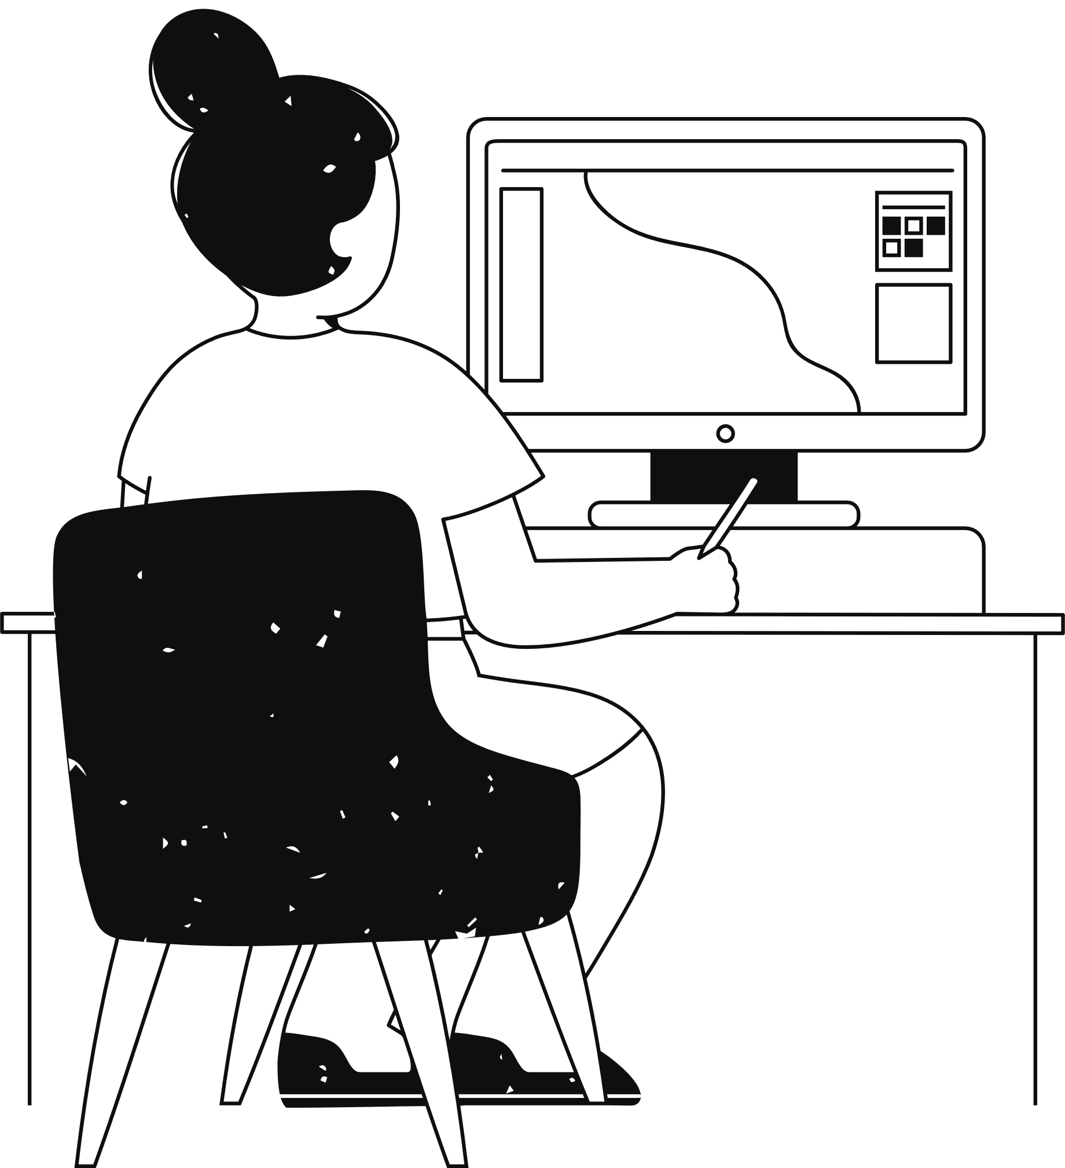









Elements
used
for
OPPORTUNE

Slide 5
How it works??
01
02
03
04
Matchmaking algorithm recommends internships to students.
Students can apply directly through OPPORTUNE simplifying the process.
Students create profiles highlighting their skills and preferences.
Companies list their internship opportunities on the platform.

Slide 6









DEMONSTRATION
FRONTEND
API LAYER
Cloud Hosting
API Management
Web App
DATABASE LAYER
BACKEND
Student
data
Company
data
Match-making
Algorithm
Match data

Slide 7
OUR FUTURE GOALS
Extend the platform to include international opportunities, connecting students with global companies.
Partner with educational platforms to offer skill-building resources that help students prepare for their desired internships.
Add a feature for students to connect, share experiences, and collaborate, fostering a supportive internship community.
Build a user-friendly mobile application for on-the-go access to opportunities and updates.
Introduce funding programs to support students in unpaid internships, reducing financial barriers.

Slide 8

Conclusion
"Finding the right internship shouldn't be a hassle. Our platform unites opportunities, saves time, and removes fees—empowering students to focus on their growth."

Slide 9

Any Questions?

Slide 10





THANK
YOU!
Visit us at:
www.link.com

